Slide 1
Global Trade Analysis
By:
Syed Zameer Afridi

Slide 2
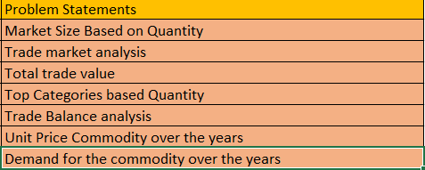
Problem Statements:

Slide 3
Overview of the project
The objective of the project was to create innovation and interactive Tableau dashboards.
The dataset contained 59090 rows and 10 columns.
The analysis is about the global trade and logistics, majorly in the countries such as USA, Canada and Australia.

Slide 4
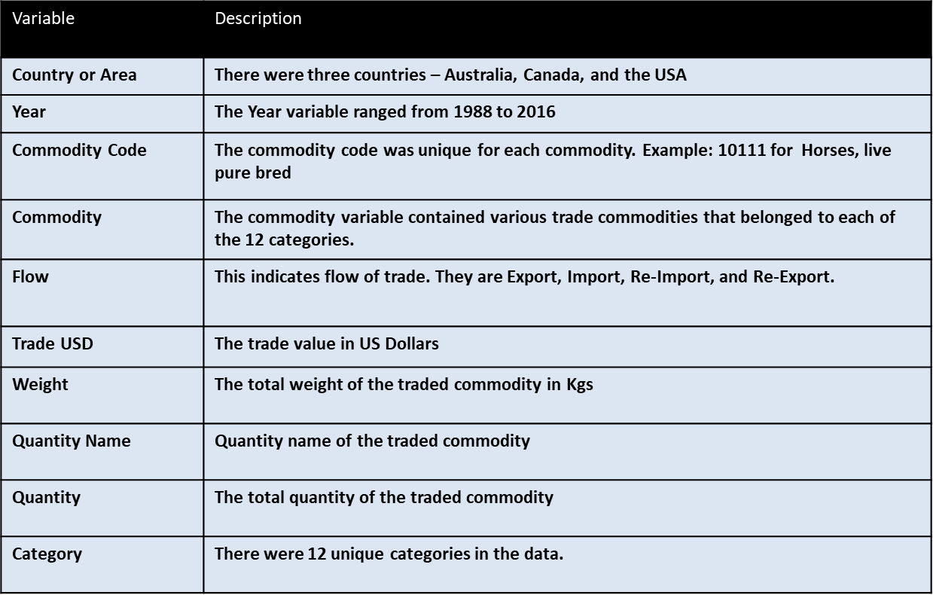
Data description

Slide 5
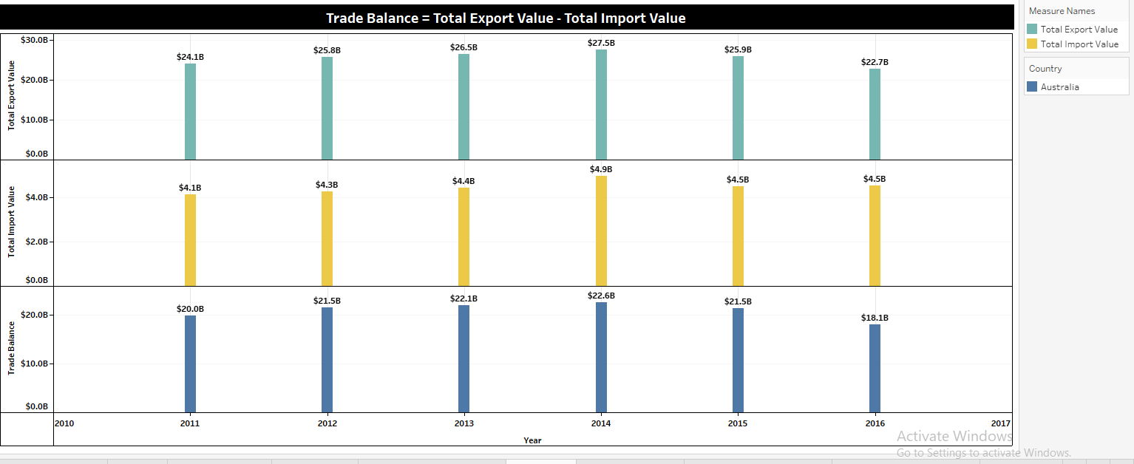
Chart

Slide 6
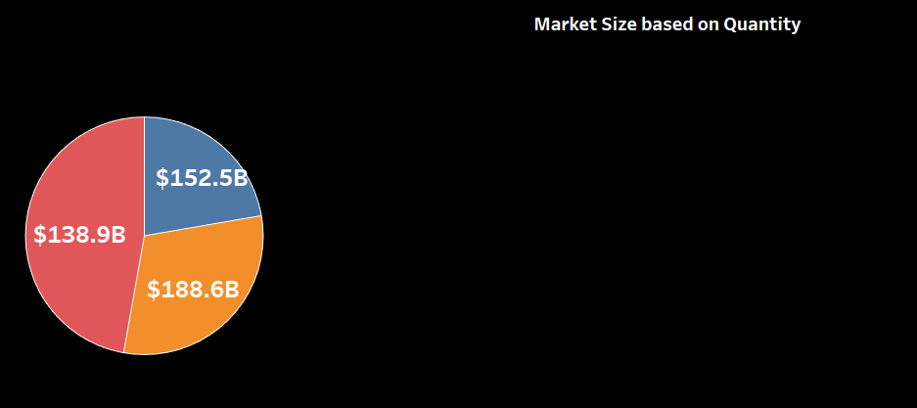
Chart

Slide 7
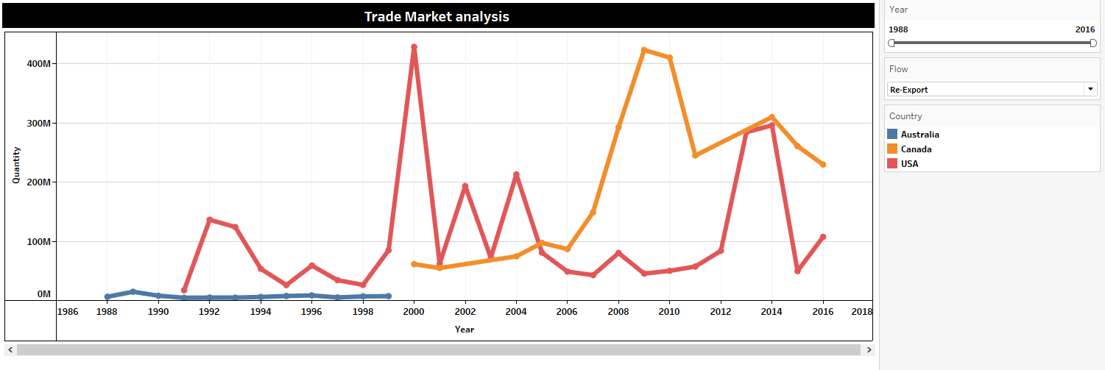
Chart

Slide 8
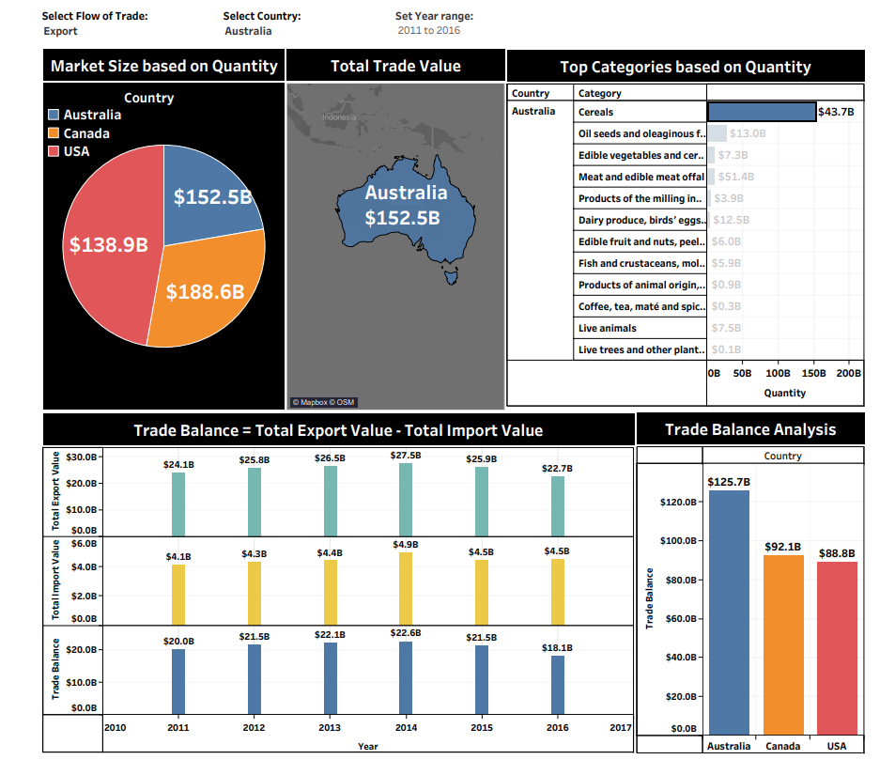
Dashboard:

Slide 9
Thank You link:https://drive.google.com/file/d/1O4nkZZQcVKsC2Px2d7bLE4rFJry0putW/view?usp=sharing

